Slide 1
Designing Applications in Python
Lecture 6 – Intro to Django Framework
Shynggys Kairatuly Alshynov
MSc in IT
alshynov@gmail.com
CE&T department, Room 409

Slide 2
Objectives
Django Framework
Create a project
Development server
Creating app
Write view(s)
path(): arguments
First Django Project

Slide 3
Learning outcomes
If someone is still reading these slides with learning outcomes then you are great!
Gain knowledge how to create projects and applications in Django!

Slide 4
What is Django Framework
Django is a high-level Python Web framework that encourages rapid development and clean, pragmatic design. Built by experienced developers, it takes care of much of the hassle of Web development, so you can focus on writing your app without needing to reinvent the wheel. It’s free and open source.
Ridiculously fast
Reassuringly secure
Exceedingly scalable
https://www.djangoproject.com/
https://docs.djangoproject.com/en/2.2/ <- strongly recommended

Slide 5
Best Products of Django (probably)
Best web applications written in Django:
1. www.Disqus.com
2. www.Bitbucket.org
3. www.Instagram.com
4. www.Pinterest.com
5. www.NASA.gov
6. www.Spotify.com
7. www.YouTube.com
8. www.TheOnion.com
According to:
1. https://www.linkedin.com/pulse/top-10-sites-built-django-framework-vladimir-bogdanov
2. https://djangostars.com/blog/10-popular-sites-made-on-django/

Slide 6
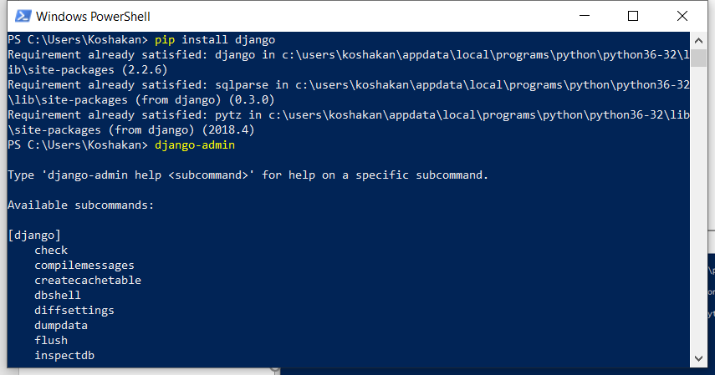
Django Installation
Open your cmd and type the command:
pip install django
Notes:
PYTHON IS CASE SENSITIVE DO NOT FORGET ABOUT IT

Slide 7
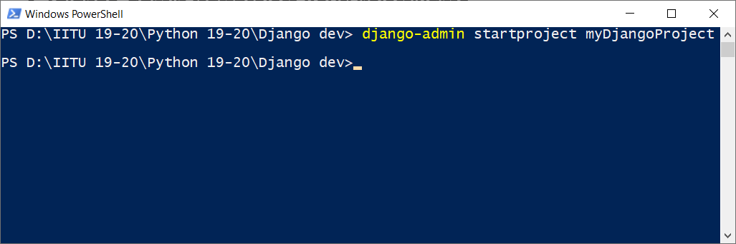
Project Creation
Open your cmd in a folder where you are going to develop your project.
Next step is to type this command:
>django-admin startproject YourProjectName
Notes:
django-admin is Django’s command-line utility for administrative tasks. This document outlines all it can do.

Slide 8
Project Folder Content
So you have created a project, what is inside?
The Root folder (root project folder, the same name as the project name, can be renamed as you wish, e.g. ‘myFirstRetake’)
manage.py – almost the same as django-admin except that it helps to interact with settings.py (which is in root folder)
Inside of the root folder:
__init__.py – tells Python that this directory must be considered as a package
settings.py – project’s main configuration file
urls.py – URL declarations of the project or simply table of contents
wsgi.py – web server gateway interface.
Notes:
In addition, manage.py is automatically created in each Django project. It does the same thing as django-admin but also sets the DJANGO_SETTINGS_MODULE environment variable so that it points to your project’s settings.py file. It is a specification that describes how a web server communicates with web applications, and how web applications can be chained together to process one request.

Slide 9
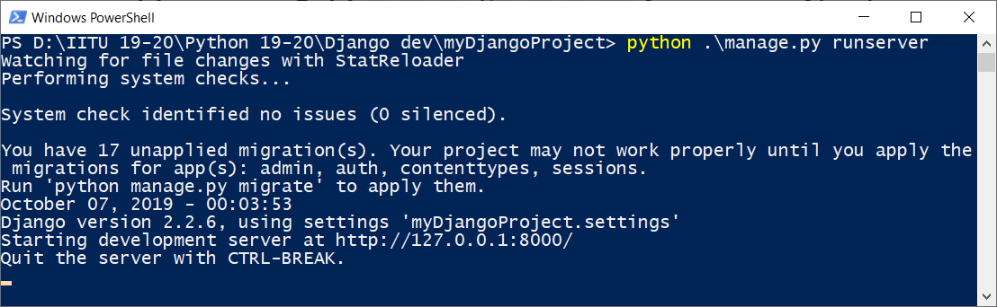
Testing the Server
After you have created a project, it is good practice to check whether your server and project are in working state. Type the following command in cmd:
>python manage.py runserver [portNumber (default 8000)] <-optional

Slide 10
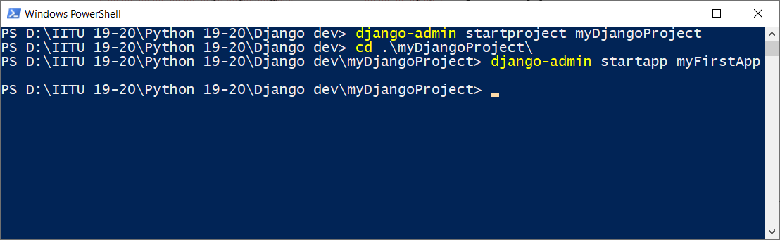
Application creation
To create an application inside of your project, you need to change your directory to the main working directory, where your rootDirectory locates, and type next command in cmd:
rootDirectory>django-admin startapp myFirstApp
Notes:
Your apps can live anywhere on your Python path. we’ll create our app right next to our manage.py file so that it can be imported as its own top-level module, rather than a submodule

Slide 11
Application folder content
myFirstApplication directory content:
__init__.py – tells Python that this directory is a Python package
admin.py – admin part of your project/app
apps.py – your apps
models.py – here you define classes that will describe behavior of your app
tests.py – is needed to test the application/models
views.py – used to return ‘pages’

Slide 12
Relaxation page

Slide 13
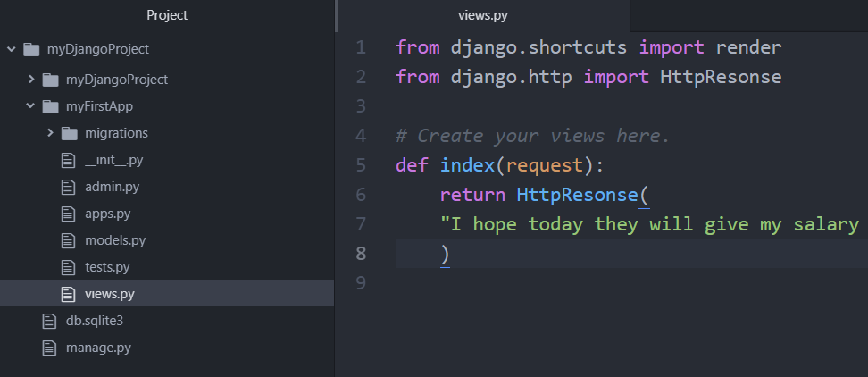
Writing Simple Views
To write a view you need to open a file views.py in the application folder (simplest view)
Write this lines of code:

Slide 14
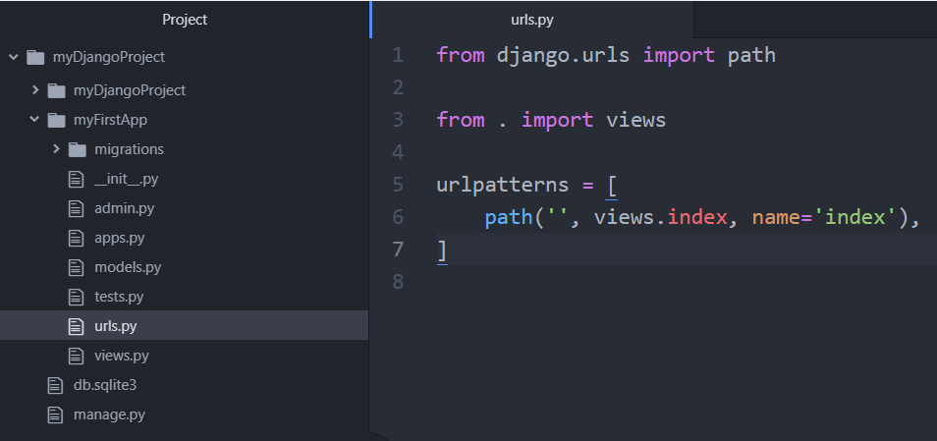
Calling the view
To call the view we need to reference to this view in our urls.py file which you need to create in application folder.

Slide 15
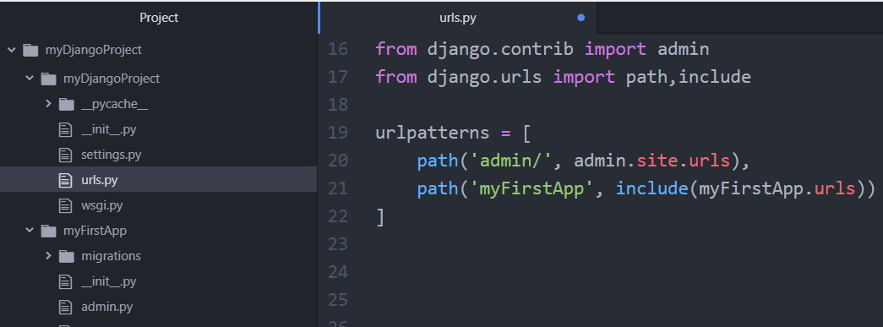
Reference to application’s url
Finally, to call the written view we need to reference it inside of the rootDirectory urls.py file.
Notes:
The include() function allows referencing other URLconfs. Whenever Django encounters include(), it chops off whatever part of the URL matched up to that point and sends the remaining string to the included URLconf for further processing.

Slide 16
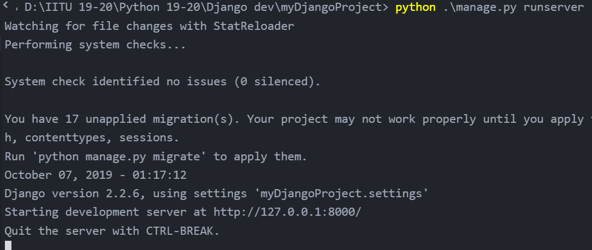
Verification of the working view
Now type the command from your working directory (rootDirectory) this command to see the results:
rootDirectory>python manage.py runserver
Notes:
The include() function allows referencing other URLconfs. Whenever Django encounters include(), it chops off whatever part of the URL matched up to that point and sends the remaining string to the included URLconf for further processing.

Slide 17
path() function
path() function requires 2 arguments to be passed and 2 are optional:
route – string that contains URL pattern. Django starts at the first pattern in urlpatterns and makes its way down the list, comparing the requested URL against each pattern until it finds one that matches
view - when Django finds a matching pattern, it calls the specified view function with an HttpRequest object as the first argument and any “captured” values from the route as keyword arguments.
kwargs - Arbitrary keyword arguments can be passed in a dictionary to the target view.
name - Naming your URL lets you refer to it unambiguously from elsewhere in Django, especially from within templates. This powerful feature allows you to make global changes to the URL patterns of your project while only touching a single file.
Notes:
The path() function is passed four arguments, two required: route and view, and two optional: kwargs, and name

Slide 18
Summary
Now you know how to create projects and apps in Django!

Slide 19
Code examples
Make serious faces, please. Even if it is hard for you.

Slide 20
Thank you for your attention!
Python is Victorious! ☺

